Slide 1

Exploration of the
US/Iran Crisis
Through Social Media
Dawn M. Bali
MSDS 692

Slide 2
Background
US and Iranian Relationship
1979 Revolution and Hostage Crisis
1983 Beirut Bombing
1988 Tanker War
1996 Iran/Libya Sanction Act
2002 Axis of Evil Stat of the Union Speech
2010 Iranian Nuclear Facility Stuxnet Infection
2015: JCPOA
2018 Maximum Pressure

Slide 3
Research Questions
Were Americans in favor of assassinating BG Soleimani and by proxy, President Trump’s Iran foreign policy?
To what extent, if any, were Iranians in favor of the assassination?
Aside from the US and Iran, what was the sentiment of the rest of the world?
Does it vary by region (Middle East, Far East, Europe, Africa, Americas) or follow along the lines of other divides (commonwealth States, former Soviet, Islamic)?
How did the sentiment vary over the span of collection, noting key events?

Slide 4
Key Events
Date | Event
Dec 27, 2019 | Kata’ib Hezbollah (KH) attack that killed one American.
Dec 28, 2019 | US retaliatory strike against five KH targets, killing 25 militants.
Dec 31, 2019 | US Embassy in Baghdad mobbed and breached by protestors
Jan 3, 2020 | US assassination of BG Qassem Soleimani
Jan 7, 2020 | Iranian retaliatory strikes on American barracks in Iraq.
 | IRGC shoot down PK752, killing 176 civilians.
Jan 11, 2020 | IRGC BG Amir Ali Hajizadeh publicly acknowledged Iranian responsibility.

Slide 5

Data
Twitter content from December 26, 2019 – January 25, 2020
Keywords: Iran protests, Tehran, Khamenei, Qassem Soleimani, Ukraine International Airlines flight PS752
Hashtags: iran protests2020, iranprotestors, Tehran, Khamenei, qassemsoleimaini

Slide 6
Methodology
Exploratory Data Analysis, with collection and cleaning
Use/compare three different types if sentiment analysis
  Feature-based: logistic regression and SVM
  Embedding-based: FastText and Flair
  Rule-based: TextBlob and VADER
Visualizations

Slide 7
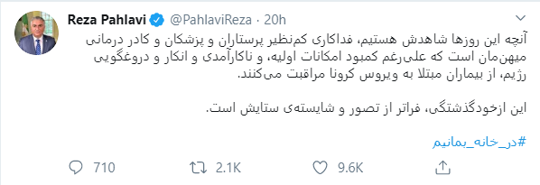
Challenges
Anticipated
Foreign language natural language processing
Cleaning and formatting Twitter content

Slide 8
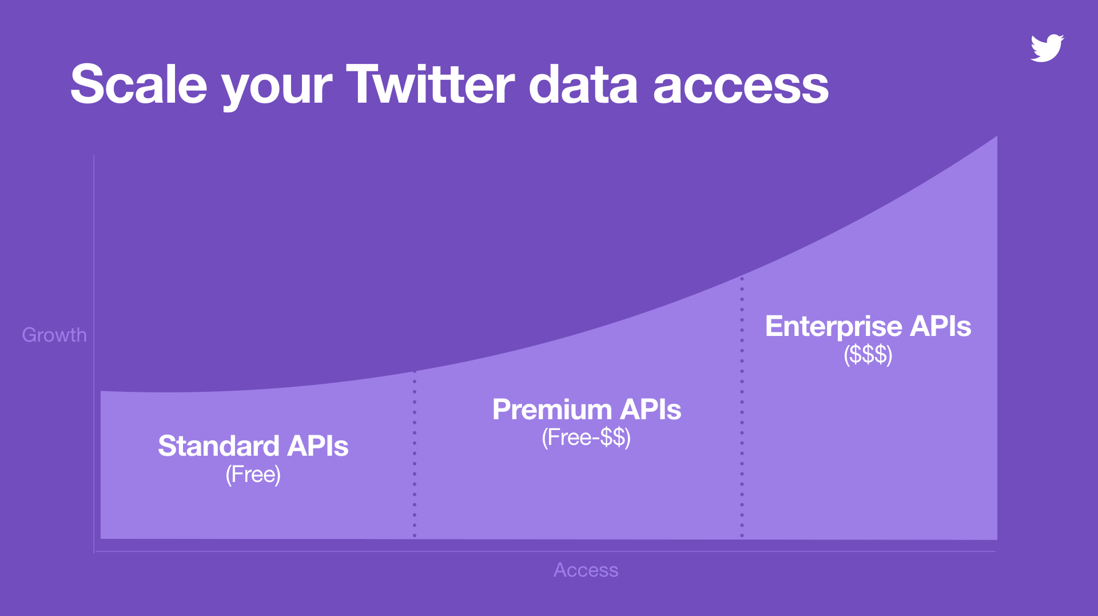
Gaining Access

Slide 9
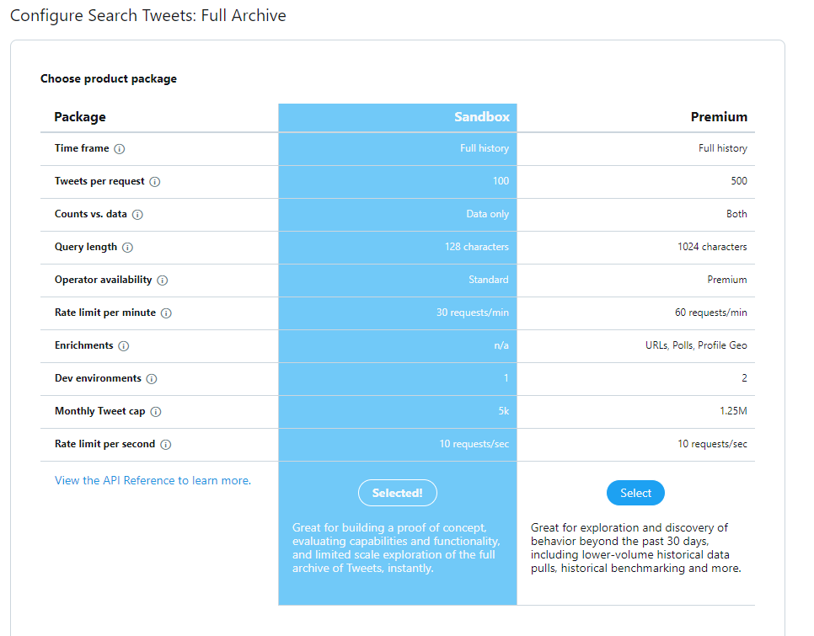
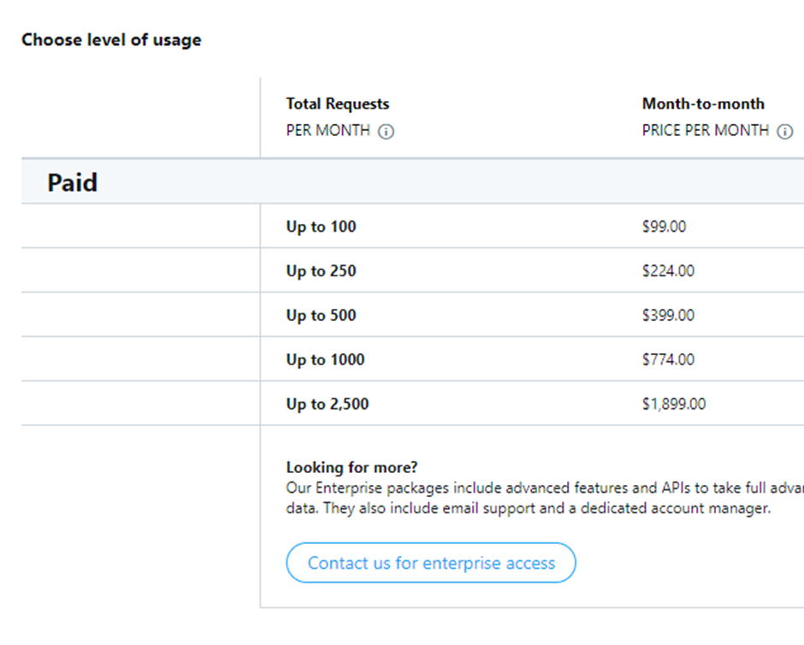

Slide 10
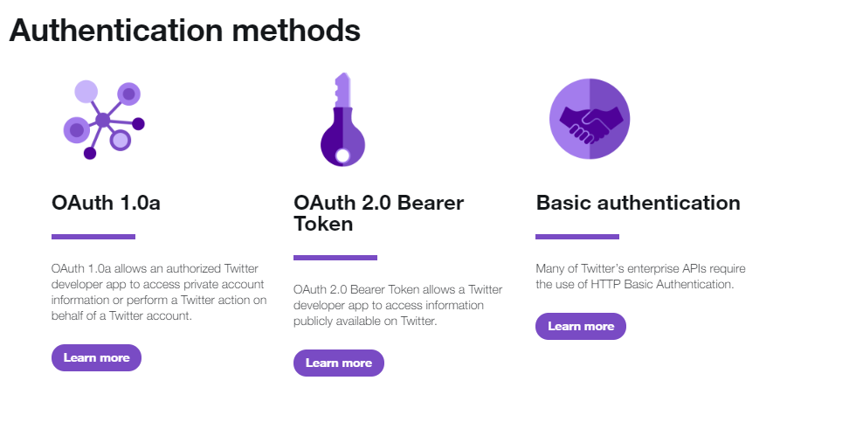
Credential Roadblock

Slide 11
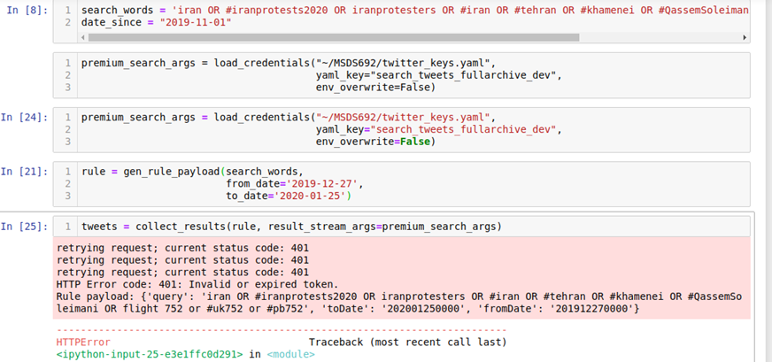
Status Code 401

Slide 12
Way Forward
Troubleshoot credential error
  Free Premium search criteria
  Inspect credential/token usage
  Seek documentation clarity
Change topic to timely COVID-19 and perform similar analysis using the Standard API
Continue Project into Practicum II

